Slide 1

Opening a Gym in London 2021
Carter C

Slide 2
London’s Health in 2021
Since the 2000’s obesity has been on the rise within the UK .
Cancer Research UK declared obesity to be the second biggest cause of preventable cancer in the UK in early 2021.
Obesity related fatalities have been exacerbated by the Covid-19 pandemic.
For the severely obese there is a direct impact of 240 and 479 excessive deaths in England and an indirect effect of 383 -767 deaths. (The Royal Society of Public Health)
Thus, the prevention of obesity and promotion of physical activity are as important as isolations methods.

Slide 3
The problem
What is the best and safest way to become more physical active?
Why is safety and issue:
Potential of contracting Covid
Potential of future lockdown restrictions hindering activity

Slide 4
How can Data analysis Help?
Data might prove effective in alleviating some of the worries.
We can aim to predict which areas are likely to improve on over health of their borough and which borough may be more resistant to a high reproduction rate of covid in the future

Slide 5
Who is the Target Audience?
People considering moving to or within London.
People who want to increase their physical activity.
People who want to join a gym or switch gyms.
People who want to open a gym or fitness centre.
People considering investing in property in London.

Slide 6
What Data is used
National Office of Statistics’ Health Index Data
A set of statistics used to determine a broad measure health used to compare boroughs
Healthy People – A measure that focusing on health outcomes (Mortality, Physical Health Conditions, Difficulties in daily life etc.)
Healthy Lives – A measure health-related behaviours and personal circumstances (Psychological risk factors, behavioural risk factors, unemployment etc)
Healthy Places – wider determinants of health, environmental factors (Access to green space, local environment, access to services)
Nation Health Service Vaccine statistics
The cumulative number of Covid Vaccinations per borough

Slide 7
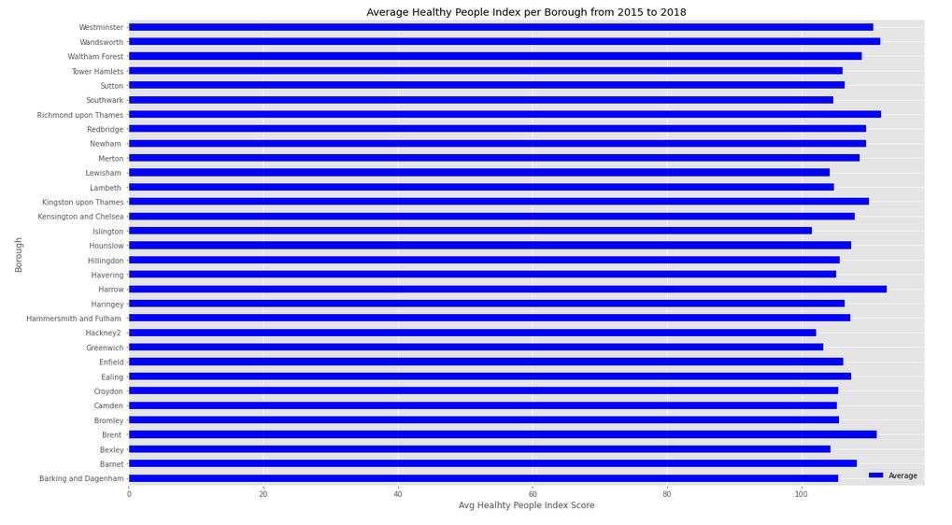
Health People

Slide 8
Health People (2)
The bar graph visualises the average health outcomes of people in each borough from 2015 -2018.
The borough Harrow has the highest score with an AVG of 112.63.
In comparison to other boroughs, people in Harrow would have a low mortality rate, better physical health, less or minor problems in daily life, better personal well-being and mental health.
This is attractive for those looking to move to or join a gym in Harrow
Islington has the lowest score, with an AVG of 101.25
In comparison to other boroughs Islington has a higher mortality rate, lower physical health, less or minor problems in daily life, better personal well-being and mental health
It is important to note, that these averages only offer one perspective of looking at the data.

Slide 9
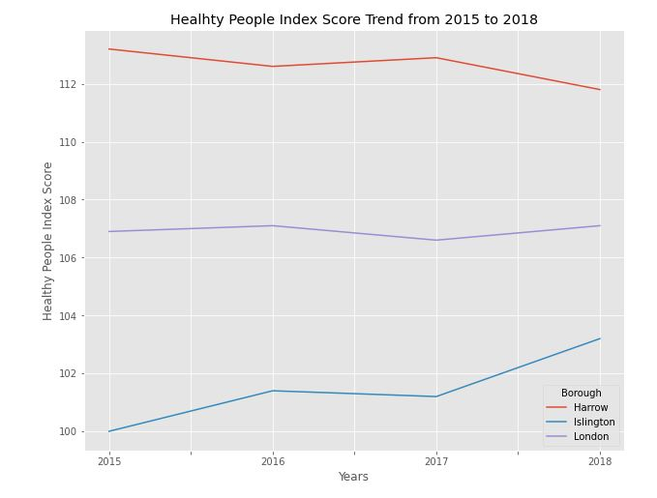
Health People (3)

Slide 10
Health People (4)
Harrow has a higher average score than Islington. However, Harrows AVG has declined from year to year.
This may be a negative factor for those looking to invest
Islington, while an overall lower average, has improved from 2015 to 2018.
By examining these two boroughs against the whole of London. We can that Islington, like that of London, is on an upwards trend.
Harrow is then going against the overall trend of London. While the rest of London has improved. Harrow hasn’t.
To have a better picture of whether or not a borough is improving. We should take the average of the changes between each year rather than only examining the average scores.

Slide 11
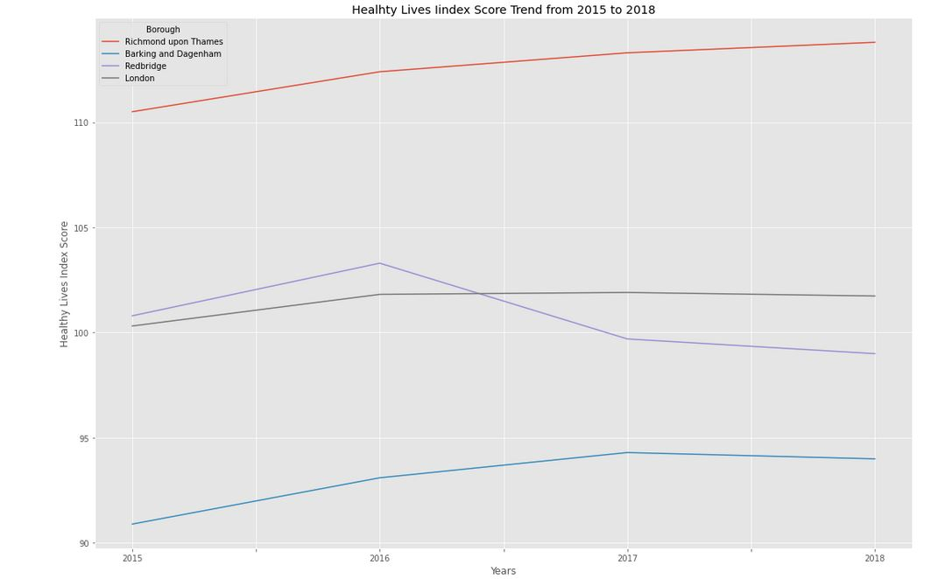
Health Lives

Slide 12
Health Lives
Barking, in comparison to other Boroughs, has higher Psychological and behavioural risk factors, unemployment, worse working conditions, and higher risk factors for children.
Barking has seen no improvement from 2015. And has deteriorated from 2017 to 2018.
This is makes Barking less attractive for investments.
Richmond Upon Thames, has seen consistent improvement in these attributes.
Important for people looking to live or work in London
Redbridge’s trend is important as it illustrates. That boroughs can experience vastly different economical and social changes from year to year

Slide 13
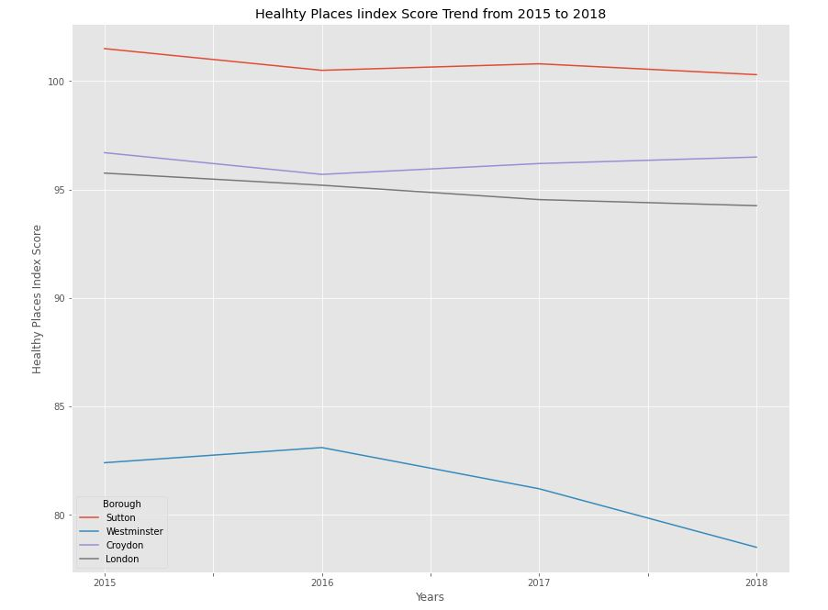
Health Places

Slide 14
Health Places (2)
The lowest ranked boroughs are Westminster, Camden, and Kensington and Chelsea respectively.
These are all located within the centre of the London
There is less green spaces
The top scorers are Havering, Bexley, and Sutton respectively.
They are all located on the outskirts of London, so they will have a much higher trend and score.

Slide 15
Healthy Places (3)
Why is London Trend Down?
It is difficult to accurately determine why London’s overall trend in declining.
One explanation is that due to an increasing population, demand for housing and services.
As each borough develops land. There is less and less green spaces in the city.
Another is as population grows, there is an ever increasing demand for housing but less access to housing or services.

Slide 16
London’s Healthiest Boroughs
The overall score of each borough is the average of each of its scores: Healthy people, lives, and places over each year.
The best borough is Richmond up Thames.
For those looking to move to london this may be the best place to move to.
Arguably, it is more important to look at the average changes each borough has seen over the years
Highly important to the target audience who are looking to invest in boroughs that are developing and will have better scores in the future.

Slide 17
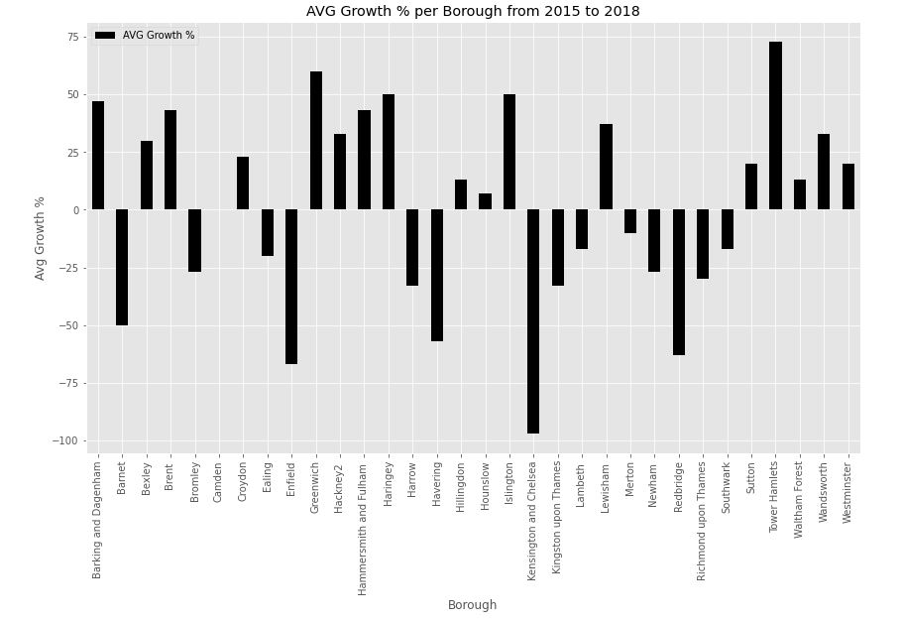
AVG % Growth per Borough

Slide 18
Where is the Best Place to Invest in a Gym?
In the Long term, this may be Tower Hamlets.
Tower Hamlets has drastically improved from 2015 to 2018.
The borough is seeing a lot of development and could continue to improve further down the line.
As a business owner or potential business owner this is can be incredibly attractive.
Low costs to obtaining property now as its underperforming and there are lots of issues to be addressed.
May incur a higher risk. No guarantees that it continues to develop.
In the Short term, we have to first consider the Vaccine Data.

Slide 19
Vaccine Data
Enfield, (at the time of this data) has the highest number of fully vaccinated residents.
Potentially one of the more robust boroughs in London to future lockdowns and covid case
Tower Hamlets current has the highest number of residences who have received one does of the vaccine.
They will eventually have the highest rate of vaccinated residence, provided they maintain an efficient vaccination rate
Tower Hamlets is borough that is on the rise and for prospective gym owners or business owners, this could be very enticing.
It is important to note, that this analysis doesn’t included how boroughs suffered due to the pandemic.

Slide 20
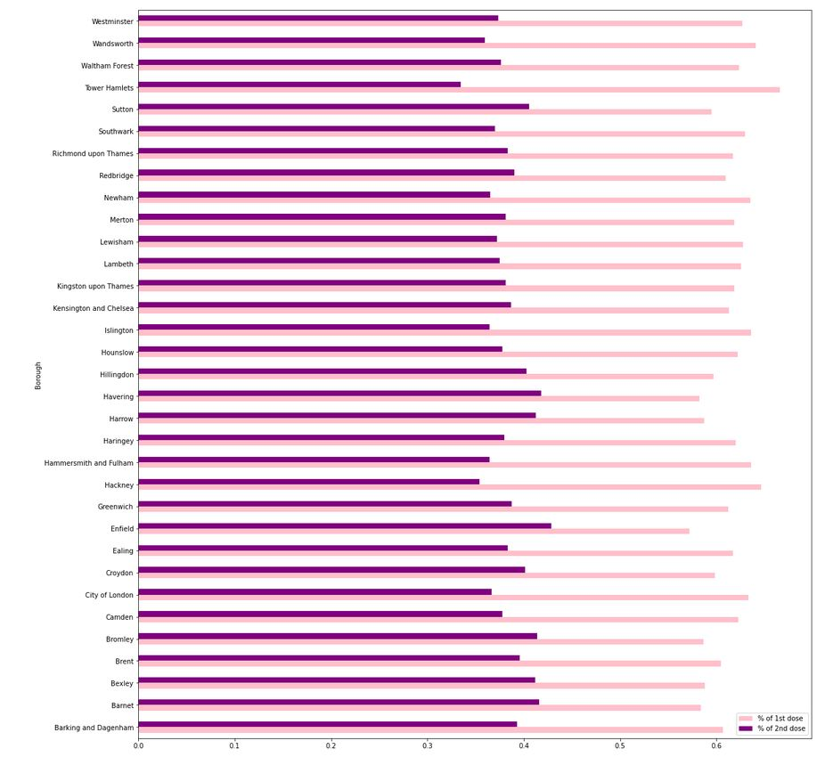

Slide 21
Joining a gym?
Southwark and Bromley 4th most common venues are gyms and fitness centres.
It is likely that they have an increased amount of price competition between gyms.
More competitive price ranges.
Bromley ranks as one of the higher boroughs on the health index but is on the outskirts of the city.
And has more green spaces.
Southwalk has a lower ranking and a lower number % of fully vaccinated residents but is closer to the city
Southwalk has a higher number of 1st dose vaccinated residents.
So it will eventually have a higher % of vaccinated residents. Thus, will be more robust to the spread of Covid19.

Slide 22
Opening a Gym
Those interested in a longer-term return then areas such as Tower Hamlets might be a good investment now
However, a shorter-term solution may be Havering.
It ranks rather high on both the health index
Havering, is also one of the boroughs with a higher number of fully vaccinated residents so it too may be more resistant to the spread of covid
Unfortunately, by looking at Havering's top 5 venues there are none that indicate that health nor fitness is a high priority in Havering.

